Slide 1

Towards a Low-Cost, Non-Invasive System for Occupancy Detection using a Thermal Detector Array
Ash Tyndall
Supervisors:
Rachel Cardell-Oliver
Adrian Keating
Program:
Bachelor of Computer Science (Honours)
Program Dates:
Semester 2, 2014 –
Semester 1, 2015

Slide 2
Introduction

Slide 3
Background
Aging population [ABS2012, CCE09]
Need to lower human burden
Rising energy prices [Swo15]
Affects both businesses and the elderly
Internet of Things
Cheaper embedded systems
Better sensors
Occupancy detection

Slide 4
Occupancy Detection
Detecting people
Good for home/office automation
Occupancy detection can save up to 25% on these costs [BEC13]
Climate control accounts for
up to 40% of household energy usage [ABS11]
43% of office building usage [CAG12]

Slide 5
An ideal system would be…
Low-Cost
Prototype stage < $300
Non-Invasive
Minimal information gathered by system
Reliable
>75% occupancy detection accuracy
Energy Efficient
Prototype can last at least a week

Slide 6
Can we create this system?

Slide 7
Necessary steps
Design Choices
Prototype Design
Hardware
Software
Criteria Evaluation
Did we meet our goals?
Notes:
5 minutes, 5 seconds

Slide 8
Design Choices

Slide 9
How do we evaluate sensors?
We want to
See individual people
We don’t want to
Know who they are
Know what they’re doing

Slide 10
Thermal Sensors
Cost is coming down fast
Exciting new area for research
Interesting applications
“ThermoSense” [BEC13]
Can see human “blobs” in thermal data
Very low resolution (8x8 pixels)
0.346 Root Mean Squared Error

Slide 11
Research Gap
Sensor space is changing fast
Contribution of system elements
Does their approach translate
ThermoSense sensor not in Australia

Slide 12
Prototype Design

Slide 13
HW Architecture – Current
Direct data collection
Raw data to processed data
Processed data to insights
Sensing
Pre-Processing
Analysis
Notes:
8 minutes, 13 seconds

Slide 14
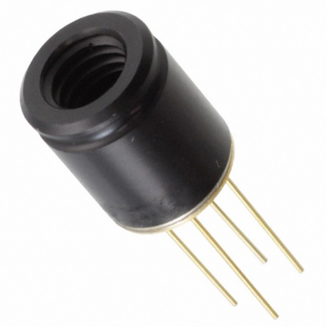
HW Architecture – Current
Melexis MLX90620
Collects thermal data
Narrower FOV (16°x60° vs 60°x60°)
Rectangular (16x4 vs 8x8)
Communicates bi-directionally
Sensing
Pre-Processing
Analysis

Slide 15
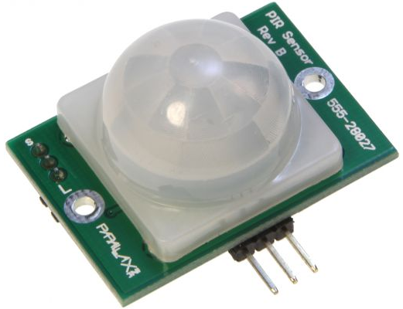
HW Architecture – Current
Passive Infrared Sensor (PIR)
Collections motion data
Provides rising signal on motion
Sensing
Pre-Processing
Analysis

Slide 16

HW Architecture – Current
Arduino Uno R3
Embedded controller with broad library support
Converts raw sensing data into degrees Celsius / motion each frame
Sensing
Pre-Processing
Analysis

Slide 17
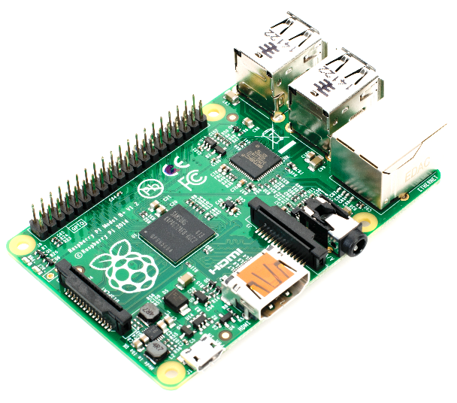
HW Architecture – Current
Raspberry Pi B+
Cheap and powerful Linux platform
Performs advanced analysis on processed data
Generates occupancy predictions
Sensing
Pre-Processing
Analysis

Slide 18
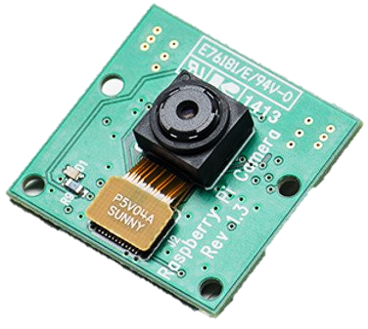
HW Architecture – Current
RPi Camera
1080p resolution
Ground truth collection in prototype stage
Sensing
Pre-Processing
Analysis

Slide 19
HW Architecture – Current
Wired
MLX90620 (MLX)
Raspberry Pi B+
Wired
Arduino Uno R3
Wired
Passive Infrared Sensor (PIR)
RPi Camera
(ground truth)
Sensing
Pre-Processing
Analysis

Slide 20



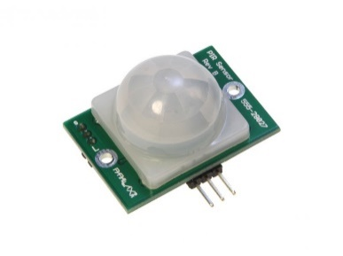
HW Architecture – Ideal M:1
Near Mains Power
Wireless
Wireless
Room A Roof
Room C Roof
Wireless
Room B Roof

Slide 21
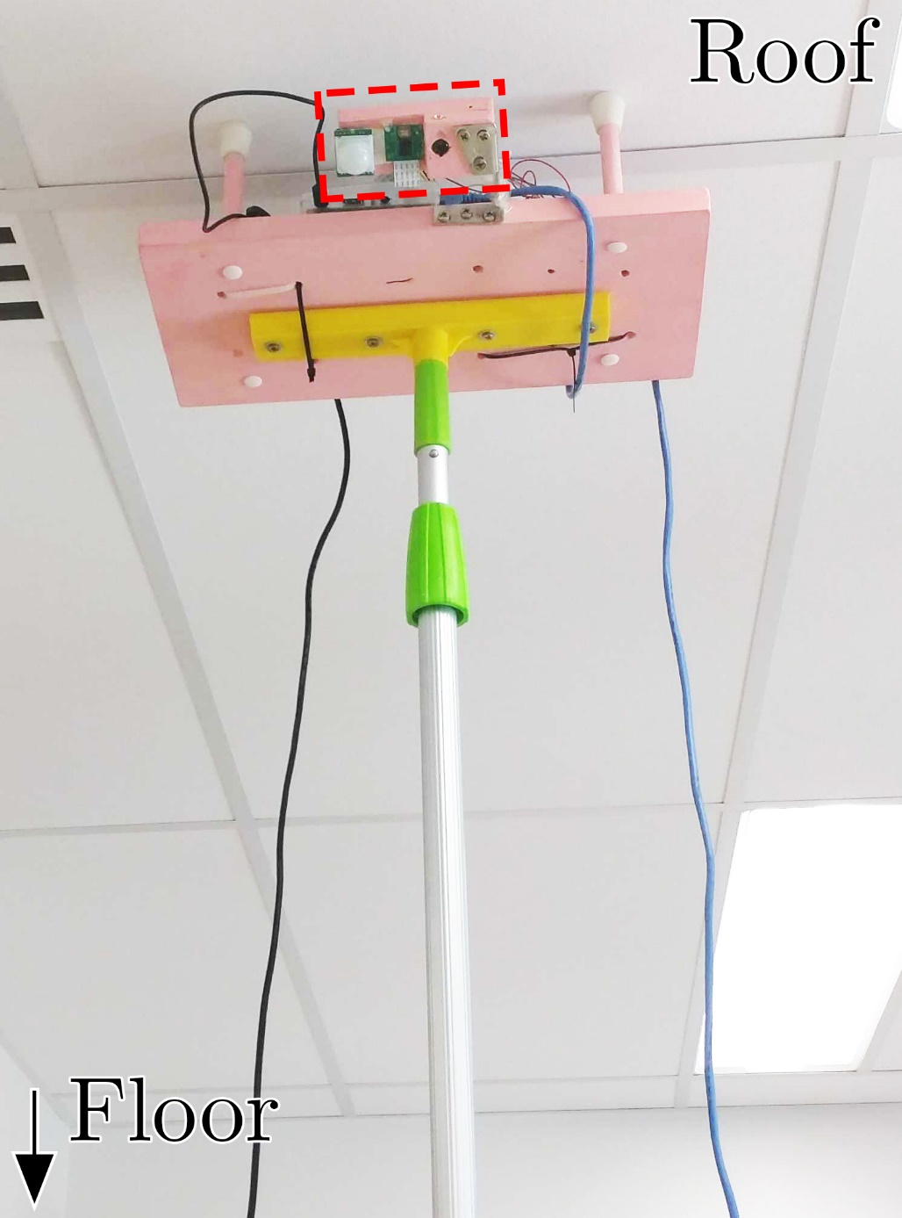
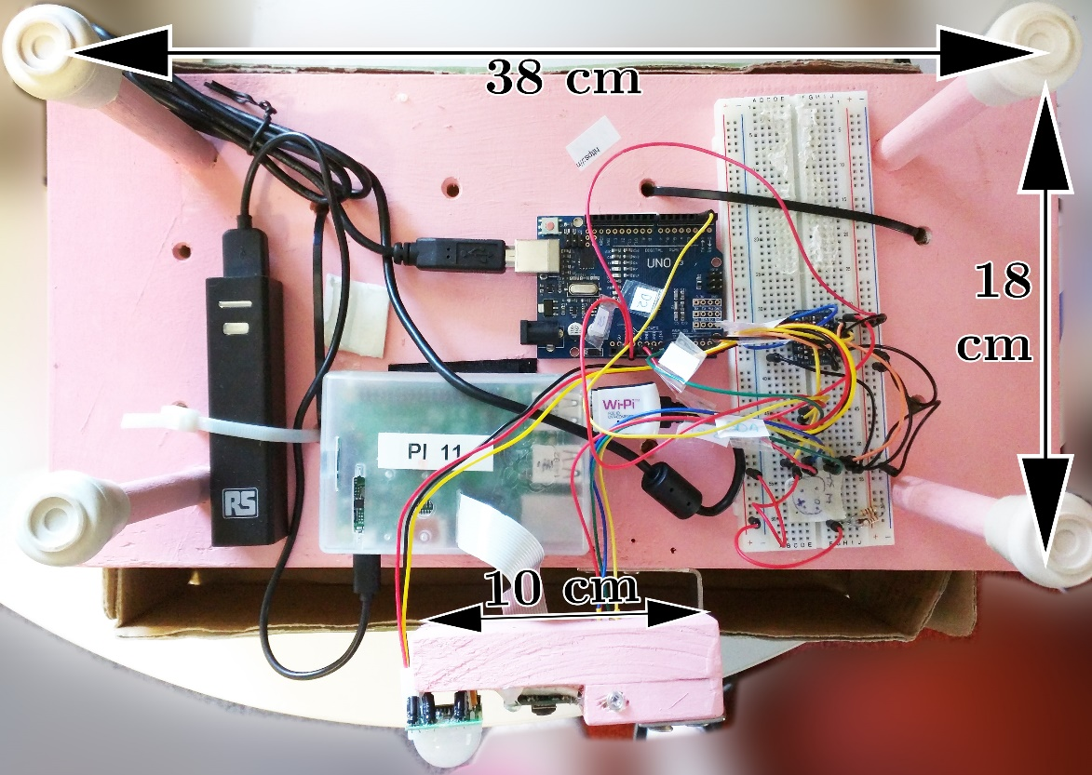
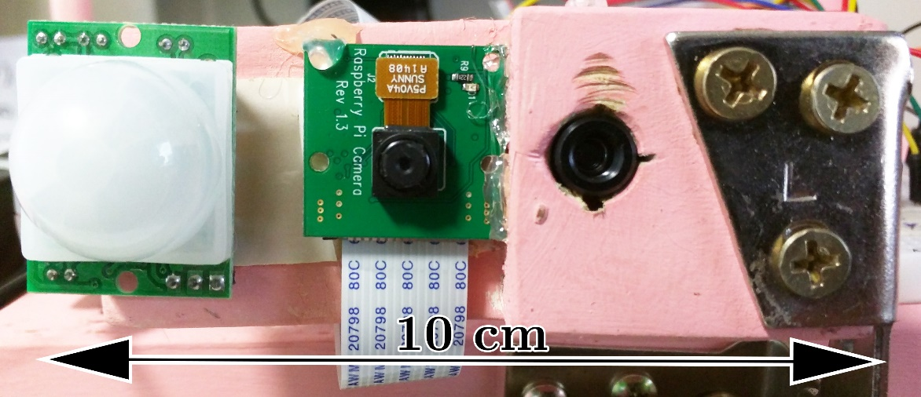
Physical Prototype

Slide 22
Software
1,600 SLOC
Approx. 500 lines on Arduino (C++)
Remaining 1,000 on Raspberry Pi (Python)
Code allows capture, visualization and analysis of thermal images

Slide 23
Technique

Slide 24
Technique
Overview
Motion detection
Image subtraction
Machine learning
Distilling good examples (feature extraction)
Providing examples with correct answer (training)
Get out a model that can predict attributes
Notes:
12 minutes, 35 seconds

Slide 25




Technique
Capture thermal image sequence

Slide 26

Technique
Generate graph from “active” pixels, which deviate significantly from mean

Slide 27
Technique
Extract features from graph for classification purposes
Number of connected components = 2
Size of largest
connected component
= 17
Number of total active pixels = 32

Slide 28
Technique
Perform machine learning
Train on examples with true value (features and ground truth)
Make predictions with your generated model

Slide 29
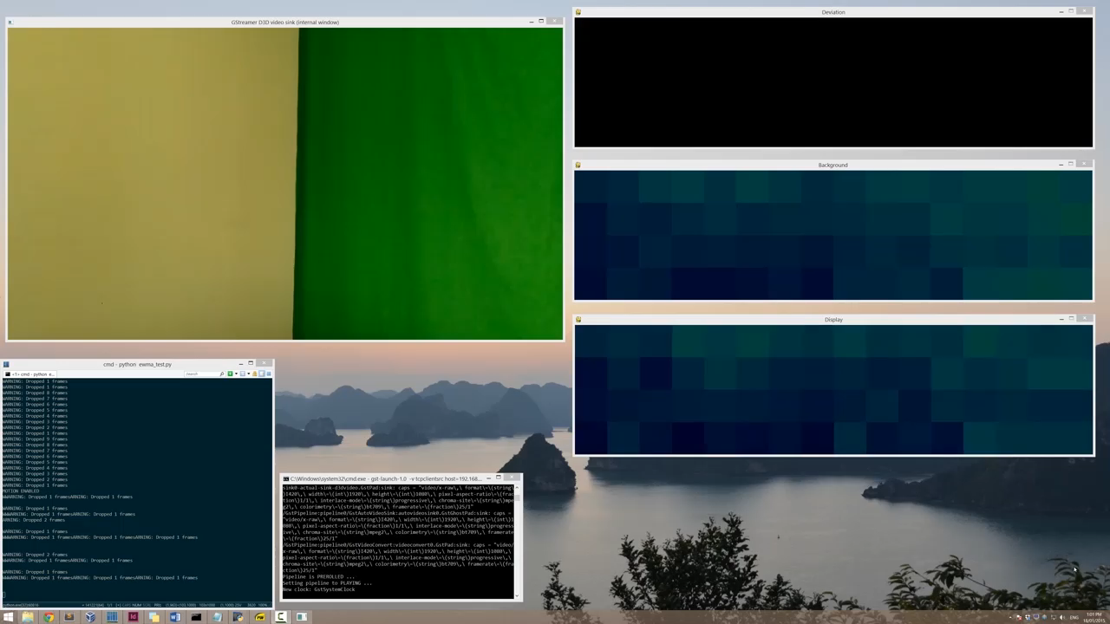
Video Demonstration

Slide 30
Evaluation

Slide 31
Non-Invasiveness
Fulfilled through sensor choice
Low resolution masks person and action identification
Notes:
16 minutes, 55 seconds

Slide 32
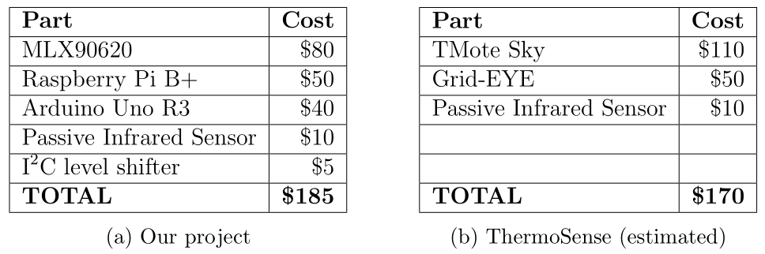
Cost
Prototype < $300 target
On par with ThermoSense cost
Cost comparison

Slide 33
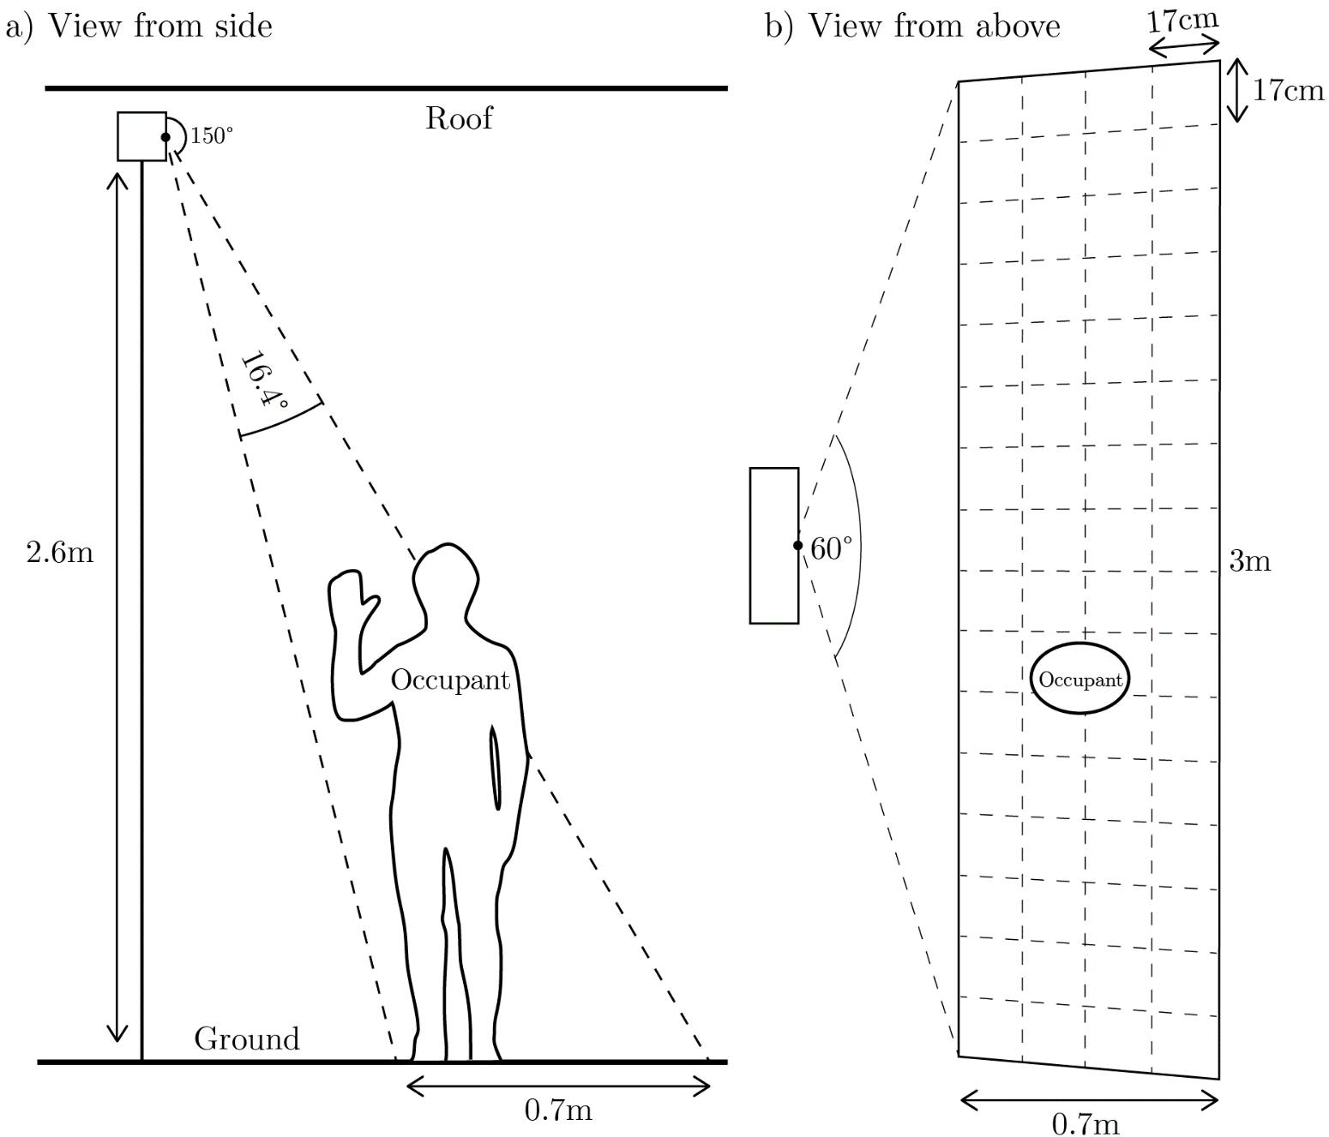
Experimental Setup
Testing reliability and energy efficiency

Slide 34
Reliability – Aim
Replicating ThermoSense’s classification algorithms:
K Nearest Neighbours (numeric / nominal)
Linear Regression (numeric)
Multi-Layer Perceptron (numeric)
Trying our own
Multi-Layer Perceptron (nominal)
K*
C4.5
Support Vector Machine
Naïve Bayes
0-R

Slide 35
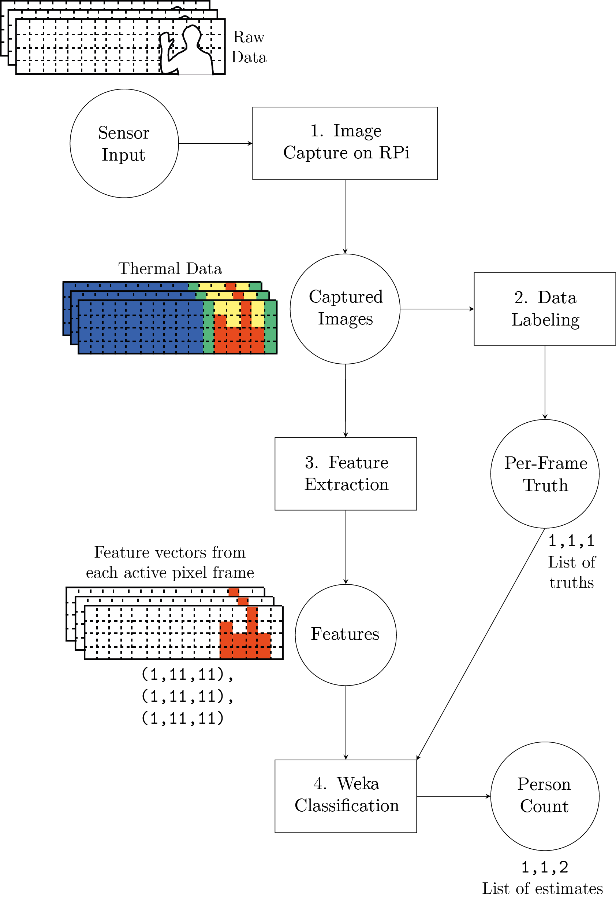
Reliability – Processing Pipeline

Slide 36
Reliability – Summary
Best results
K*, C4.5 (both ~82%)
MLP also passable (~77%)
ThermoSense paper’s choices not sufficiently reliable with our dataset
Why?
So many unknowns
Why are K* and C4.5 so much better?
Entropy?

Slide 37
Feature Plot – No Clear Cut
Notes:
21 minutes, 25 seconds

Slide 38
Energy Efficiency (log scales)
Assumes 50 Wh battery
Notes:
Bar chart
Draw goes down, life goes up

Slide 39
Energy Efficiency (log scales)
Assumes 50 Wh battery

Slide 40
Conclusions

Slide 41
Conclusions
Low Cost
$185, and will only get cheaper
Non-Invasive
Thermal sensing is a good technique
Reliable
82% classification accuracy
Energy Efficient
Prototype: 8 days. Minor changes: years

Slide 42
Recommended Future Work
IoT integration
How would this talk to other systems?
Field-of-View modifications
Undistorting captured images
New Sensors
MLX90621 (wider FOV)
FliR Lepton (80x60 pixel)

Slide 43
References & Questions?
[ABS12] Australian Bureau of Statistics. Disability, ageing and carers, Australia: Summary of findings: Carers - key findings. Tech. Rep. 4430.0, 2012. Retrieved April 10, 2015 from http://abs.gov.au/ausstats/abs@.nsf/Lookup/D9BD84DBA2528FC9CA257C21000E4FC5.
[ABS11] Australian Bureau of Statistics. Household water and energy use, Victoria: Heating and cooling. Tech. Rep. 4602.2, 2011. Retrieved October 6, 2014 from http://abs.gov.au/ausstats/abs@.nsf/0/ 85424ADCCF6E5AE9CA257A670013AF89.
[BEC13] Beltran, A., Erickson, V. L., and Cerpa, A. E. ThermoSense: Occupancy thermal based sensing for HVAC control. In Proceedings of the 5th ACM Workshop on Embedded Systems For Energy-Efficient Buildings (2013), ACM, pp. 1–8.
[CCE09] Chan, M., Campo, E., Esteve, D., and Fourniols, J.-Y. Smart homes - current features and future perspectives. Maturitas 64, 2 (2009), 90–97.
[CAG12] Council of Australian Governments. Baseline Energy Consumption and Greenhouse Gas Emissions: In Commercial Buildings in Australia: Part 1 – Report. 2012. Retrieved April 10, 2015 from http://industry.gov.au/Energy/EnergyEfficiency/Non-residentialBuildings/Documents/CBBS-Part-1.pdf.
[Swo15] Swoboda, K. Energy prices–the story behind rising costs. In Parliamentary Library Briefing Book - 44th Parliament. Australian Parliament House Parliamentary Library, 2013. Retrieved February 3, 2015 from http://aph.gov.au/About_Parliament/Parliamentary_Departments/Parliamentary_Library/pubs/BriefingBook44p/EnergyPrices.
Notes:
End: 26 minutes, 33 seconds

Slide 44
Questions?

Slide 45
Additional Content

Slide 46
Sensor Properties

Slide 47
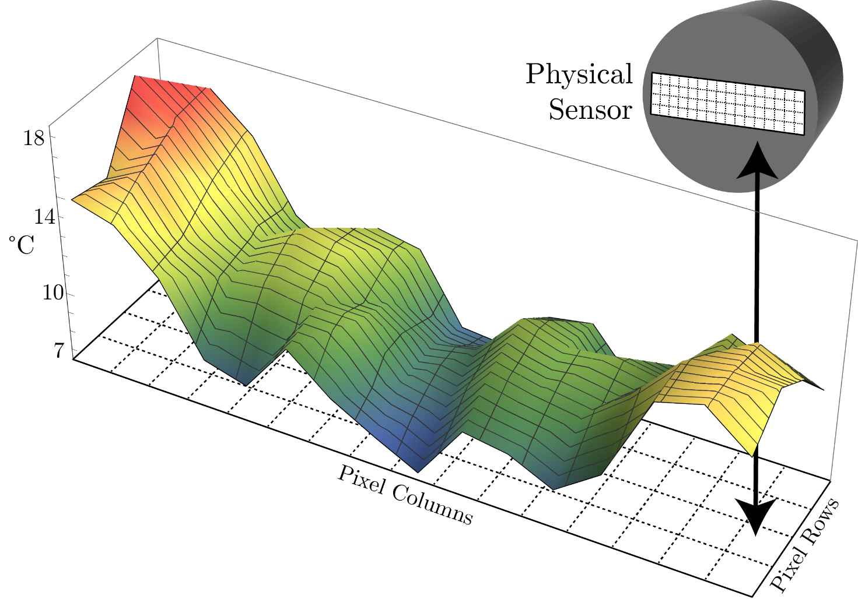
Sensor Properties – Bias
Average mean values over capture window

Slide 48
­­­­
Sensor Properties – Noise
0.5 Hz
Graphs of noise of human pixel and background pixel
2 Hz
8 Hz

Slide 49
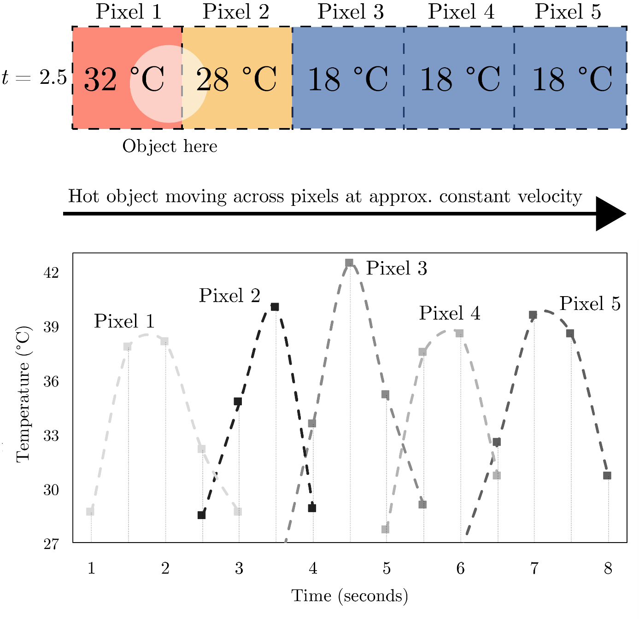
Sensor Properties – Sensitivity
Hot object moving across row of five pixels

Slide 50
Evaluating Sensors

Slide 51
How do we evaluate sensors?
Presence
Is there any occupant present in the sensed area?
[TDS14]

Slide 52
How do we evaluate sensors?
Count
How many occupants are there in the sensed area?
[TDS14]

Slide 53
How do we evaluate sensors?
Location
Where are the occupants in the sensed area?
[TDS14]

Slide 54
How do we evaluate sensors?
Track
Where do the occupants move in the sensed area? (local identification)
[TDS14]

Slide 55
How do we evaluate sensors?
Identity
Who are the occupants in the sensed area? (global identification)
[TDS14]

Slide 56
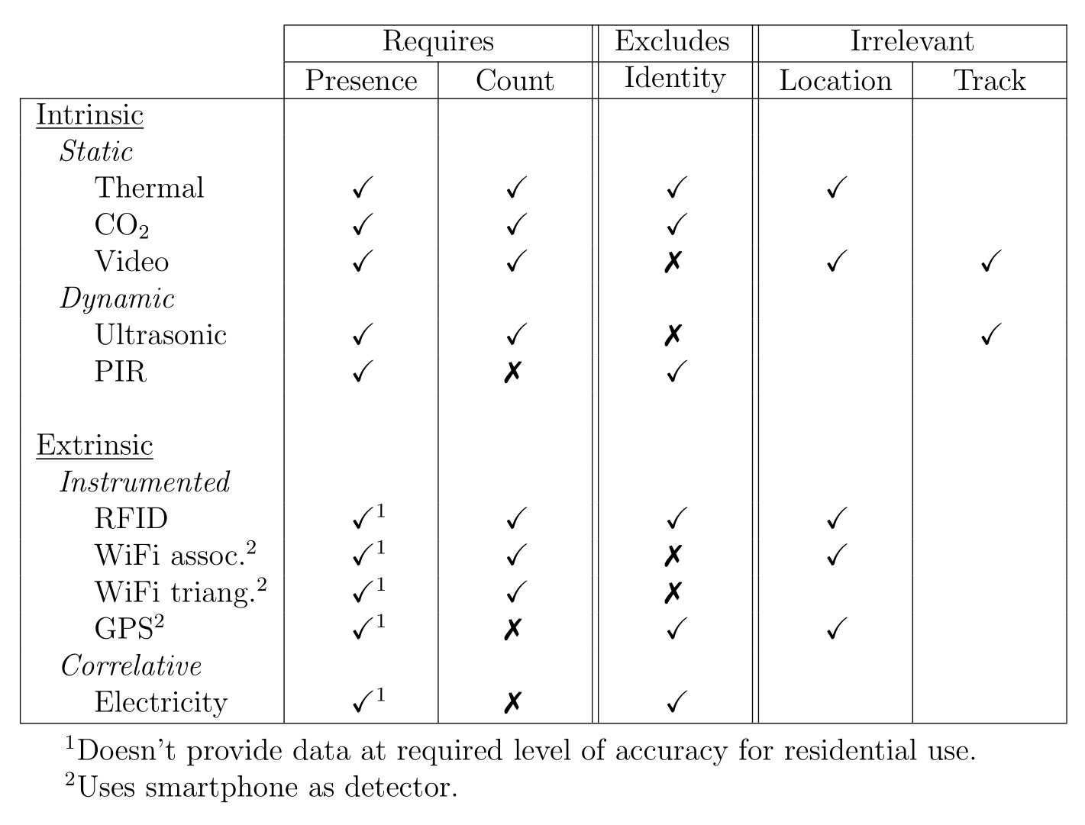
How do we evaluate sensors?
Evaluating sensors against our criteria

Slide 57
How do we evaluate sensors?
We want
Presence
Count
We don’t want
Identity
We don’t care about
Location
Track

Slide 58
References
[TDS14] Teixeira, T., Dublon, G., and Savvides, A. A survey of human-sensing: Methods for detecting presence, count, location, track, and identity. Tech. rep., Embedded Networks and Applications Lab (ENALAB), Yale University, 2010. Retrieved October 6, 2014 from http://www.eng.yale.edu/enalab/publications/human_sensing_enalabWIP.pdf.

Slide 59
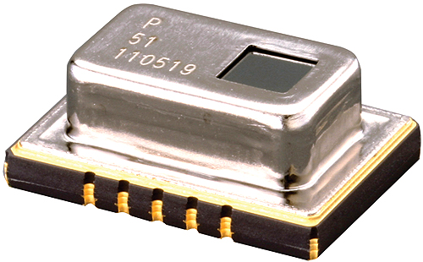
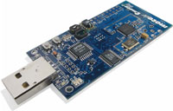
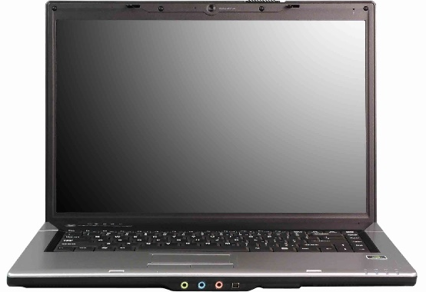
Thermosense Technique
Panasonic Grid-EYE
8x8 Thermal Array
T-Mote Sky
PC?
Passive Infrared Sensor (PIR)
Sensing
Pre-Processing
Analysis

Slide 60
Technique
Overview
Motion detection
Image subtraction
Machine learning
Distilling good examples (feature extraction)
Providing examples with correct answer (training)
Get out a model that can predict attributes

Slide 61
Technique
Capture thermal image sequence

Slide 62

Technique
When no motion (use PIR), update a background map (b), standard deviation (σ) and means using an Exponential Weighted Moving Average
b =
σ =

Slide 63
Technique
When motion, consider pixels > 3σ to be “active”

Slide 64
Technique
Generate graph from active pixels

Slide 65
Technique
Extract features from graph for classification purposes
Number of connected components = 2
Size of largest
connected component
= 17
Number of total active pixels = 32
Notes:
Explain the features in more detail

Slide 66
Technique
Perform machine learning
Train on examples with true value (features and ground truth)
Make predictions with your generated model

Slide 67
Evaluation – Accuracy
Worst – Best
Thermosense
RMSE: 0.409 – 0.346
Correlation: 0.926 – 0.946
K* Numeric
RMSE: 0.423 (-0.077)
Correlation: 0.760 (-0.166)

Slide 68
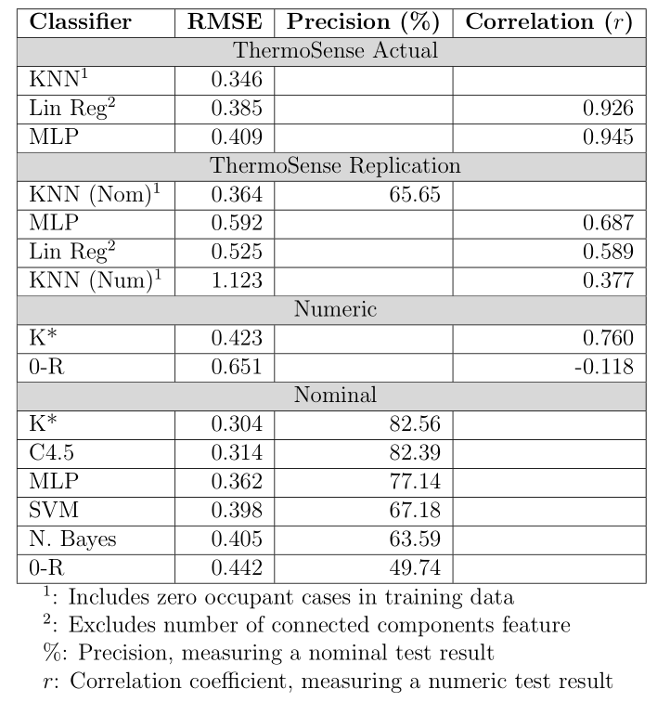
Evaluation – Accuracy
Results

Slide 69
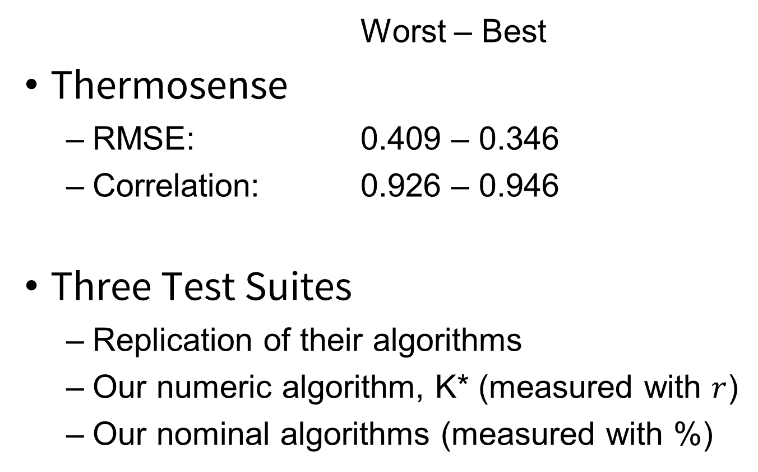
Evaluation – Accuracy
Worst – Best
Thermosense
RMSE: 0.409 – 0.346
Correlation: 0.926 – 0.946
Three Test Suites
Replication of their algorithms
Our numeric algorithm, K* (measured with $r$)
Our nominal algorithms (measured with %)

Slide 70
Evaluation – Accuracy
Worst – Best
Thermosense
RMSE: 0.409 – 0.346
Correlation: 0.926 – 0.946
Our Replication
RMSE: 1.123 – 0.364 (-0.018)
Correlation: 0.377 – 0.687 (-0.239)
Insufficient accuracy

Slide 71
Evaluation – Accuracy
Worst – Best
Thermosense
RMSE: 0.409 – 0.346
Nominal Suite
RMSE: 0.304 – 0.405 (+0.042)
Accuracy: 63.59 – 82.56
Higher end does have sufficient accuracy

Slide 72
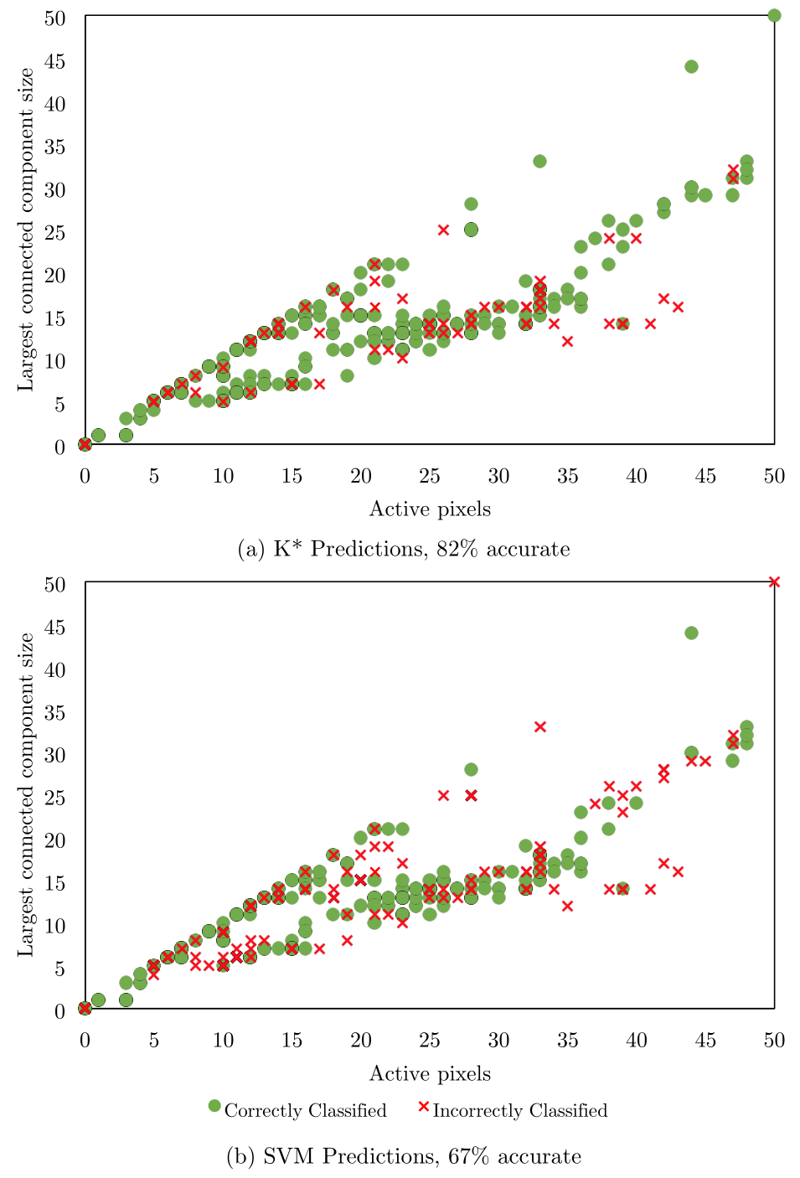
Evaluation – Accuracy
SVM Predictions
67% accuracy

Slide 73
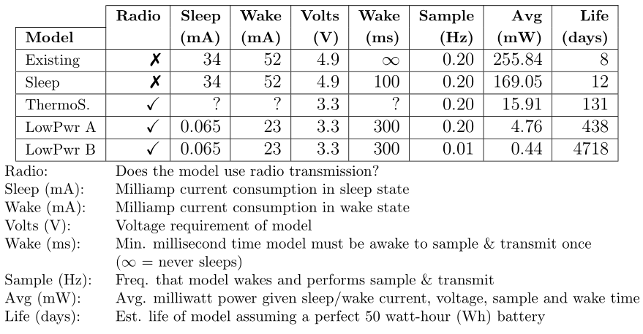
Energy Efficiency
Different Prototype Designs
Notes:
Bar chart
Draw goes down, life goes up

